Slide 1



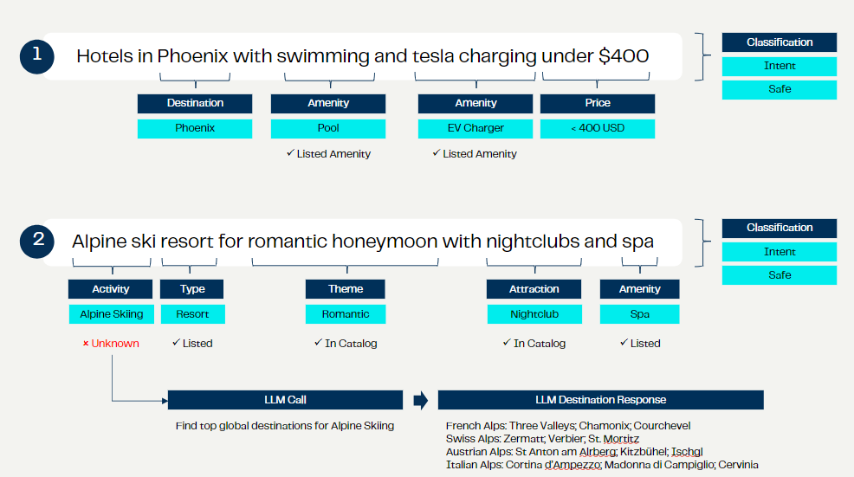

AI-Powered Intent Search Revolutionizes Hotel Bookings
Challenges
Impacts
Existing search functionality was limited to destination-based recommendations
System couldn't process natural language queries or provide recommendations based on guests' interests, activities, or specific amenities
Slow search response times impacted user experience and potential conversion rates
Existing solution lacked cost-efficiency and scalability for handling millions of monthly queries
Enabled processing of millions of monthly queries across all client-owned platforms
Improved guest experience with intuitive, natural language searches for complex travel requirements
Enhanced personalization capabilities for recommendations based on guests’ interests
Provided a foundation for future product development and functional enhancements
Reduced development time and improved speed to market for future projects
Blend partnered with a major hotel chain to revolutionize their digital guest experience by implementing an AI-powered, intent-based search solution. This innovative system interprets complex guest queries and delivers personalized property recommendations with exceptional speed and efficiency. Utilizing advanced AI technologies, including classification algorithms, entity recognition, and large language models, the solution achieves remarkable performance improvements while significantly reducing compute costs. The project is expected to generate substantial revenue through increased conversion rates and direct bookings.
Solutions
1
  Achieved a mean response time of 10ms, a 90% improvement over previous systems
Developed an AI-driven search solution with multiple components:
  Classification algorithm, toxicity filter, named-entity recognition system
  Integration of Google Gemini LLM for relevant world information
  Catalogue enrichment process to improve future query performance
Implemented AWS Trainium for model training and Inferentia2 for inference
Implemented scalable architecture using AWS services like SageMaker, API Gateway, Lambda, and CloudFormation
Created synthetic query records for training and tuning models
Optimized hardware configuration and model design for Inferentia2 deployment
2
  Reduced compute costs by 50%, with estimated annual savings of $85k to $150k
3
  Projected to generate $20-$50M in the first year through increased conversion rates and direct booking

